Slide 1
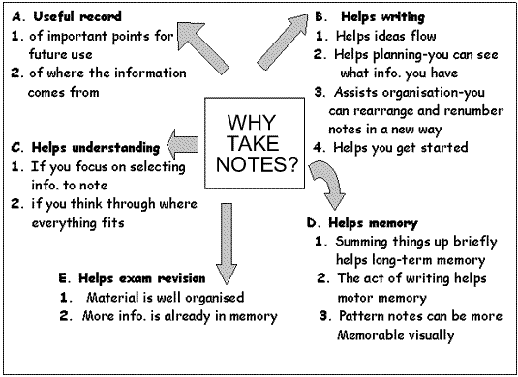
Benefits

Slide 2
Subskills
1. Abbreviating
a. abbreviate common words
b. use the first syllable instead of writing full
words out.
Word economy
a. Translate a sentence using fewer words (don’t copy sentences down word for word)
b. Just as important as abbreviating
Visual markers to organize notes
a. Use lines to separate main idea & topics
b. Highlight important information
c. Details and definitions should be numbered key words underlined
d. Leave space between main ideas to add info later.

Slide 3
Don’t Forget!...
Apply Organizational Skills
Bring proper materials to class to take notes
Keep notes organized
Use a calendar (or agenda) to plan time to review & revise notes
Read assigned material before a
class lecture

